Slide 1

Java build tools

Slide 2

Light talk authors
Danila Varatyntsev,
Senior Software Engineer

Slide 3
Build tools
Why do we need build tools? We can use default Java commands:
javac <filename>
jar cf <jar-name> <input files>
Build tools can:
Automate the process of compiling, building, testing code and deploying artifacts
Automate dependency management
Java has a rich list of build tools:
Ant
Maven
Bazel
Boot
Buck
Gradle
Ivy
etc.

Slide 4

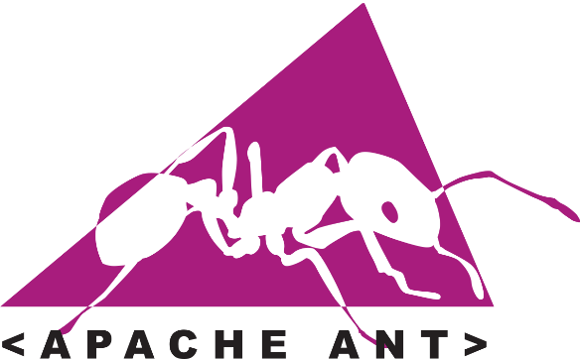

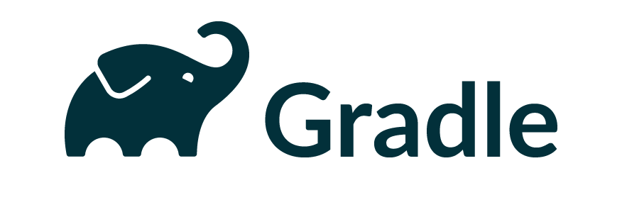
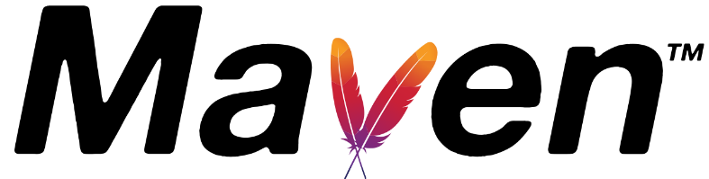
A bit of Java history
GNU Make

Slide 5
Ant
Released: June 2000
Originated from: Apache Tomcat as a replacement for Make
Build described in: build.xml file
Features:
Flexibility – doesn’t impose any conventions on file structure, user can control every step in details
Extensibility
Disadvantages:
No dependency management, just a build tool
Each step must be explicitly configured

Slide 6
Ant
build.xml can contain:
Targets – Ant’s name for tasks or jobs. Targets can depend on one another
Properties – to avoid duplication of file names, constant strings
Paths – to avoid duplication of paths
Each target has its own set of properties based on its type
You can call the default target with a simple ant command, or desired with ant <target-name>

Slide 7

Maven
Released: July 2004
Built for: Cover Ant problems
Build described in: pom.xml file
Features:
Extensibility – supports a wide range of plugins, custom plugins can be created, too
Dependency management
Disadvantages:
Long XML configuration
Dependency must be present in a maven repository to be importable

Slide 8
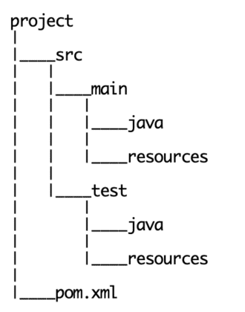
Maven
pom.xml – an XML file that describes:
how the software project being built
dependencies on other external modules
the build order
required plug-ins
pom.xml uses conventions for the build procedure

Slide 9
Maven Repository
A Maven Repository – is a location, usually on a filesystem (remote or local), where Maven artifacts are stored and managed. Repositories can be public (anyone can access them), or private (access is granted by password, for example, inside the company).
Stored artifacts are available for retrieval and inclusion in other maven projects.
Public repositories:
Central repository
Sonatype Releases - staging repository to promote releases to Maven Central
Jboss
Local Maven repository - ~/.m2

Slide 10
Maven Lifecycles and Phases
Lifecycle is a container for phases. There are three built-in build lifecycles:
default – handles the project’s deployment
clean – handles cleaning
site – handles the creation of your project's web site.
Each lifecycle is defined by the list of phases, which are executed sequentially.
Phases are made up of a set of goals. Goals represent a specific task that contributes to the building and managing of a project. Sometimes, a maven goal is not bound to a build phase.
Plugins are set of goals, that may be bound to phases.

Slide 11
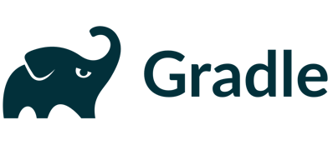
Gradle
Released: April 2008
Created for: Fulfill the problems of Maven
Build described in: build.gradle or build.gradle.kts file
Features:
Groovy or Kotlin DSL – you can use usual coding for specifying your builds
Uses cache to run only tasks that have changed since the previous run
Supports Maven conventions, but you can override them
Highly customizable with plugins
Official tool for Android builds
Gradle Wrapper can be used to avoid manual installation
Supports different repository types (Ivy, Maven)

Slide 12
Gradle
Disadvantages:
Complexity – you have to write code in Groovy or Kotlin, so there appears a learning curve
Flexibility isn’t always required, especially for small projects

Slide 13
Maven vs Gradle
 | Maven | Gradle
Config file | pom.xml | build.gradle
Performance | Worse, because all tasks must run every time | Better, because built-in cache tracks changes
Configuration is written with | XML | Groovy or Kotlin DSL
Lines of configuration | More, XML has more duplications | Less, DSL can configure many things in a single line
Complexity | Depends, may be lower for a small projects | Depends, usually lower for big projects

Slide 14
How to choose a tool?
Gradle is a good selection for new projects – it’s faster, more readable, shorter, you can use Kotlin or Groovy programming languages.
If the client already has other projects built with Maven, continue using it.
You may also select maven, if the team has much more experience with it, but it may be a good chance to learn gradle.

Slide 15
QA
Do you have any questions?

